Slide 1
AI for Power bi
Copilot in coding
Power bi Ai visuals
Q&A
Key Influence
Decomposition tree
Narrative (witch give you summarry on what you have in given pbi page )
3. OpenAi in Power query
4. Use open souce LLM (ollama for power query)
5. Remove unsed measure and columns using Measure killer
6. Datamodel optimization using Dax studio-Vertipaq and LLM (chatGpt , Clause)
7. Count filers visually and dynamically on a current report

Slide 2
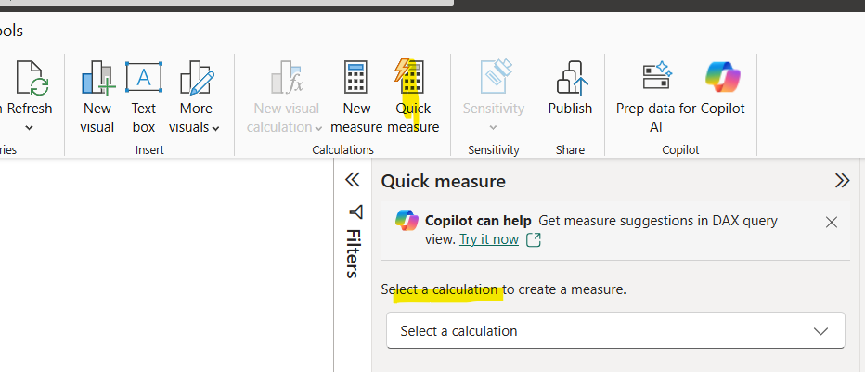

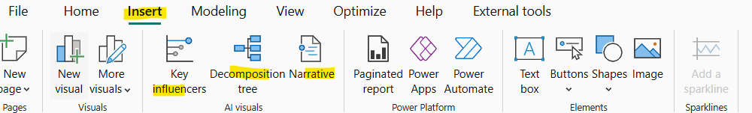
AI for Power bi
Copilot : This need to be enable for tenant settings then copilot will appear near the quick measures and you ask in natural language wicth measures you want to write
https://www.udemy.com/course/microsoft-power-bi-masterclass-expand-excellence/learn/lecture/44989203#overview
Other AI tools in Power BI in action see above visual

Slide 3
OpenAi in Power query
OpenAi in Power query : You can use openAI prompt to enrich a give table by creating a function.
See below video : https://www.udemy.com/course/microsoft-power-bi-masterclass-expand-excellence/learn/lecture/45915177#overview

Slide 4
Use Open source LLM pour power bi
We use ollama witch is an open source for this .
https://www.udemy.com/course/microsoft-power-bi-masterclass-expand-excellence/learn/lecture/46327421#overview

Slide 5
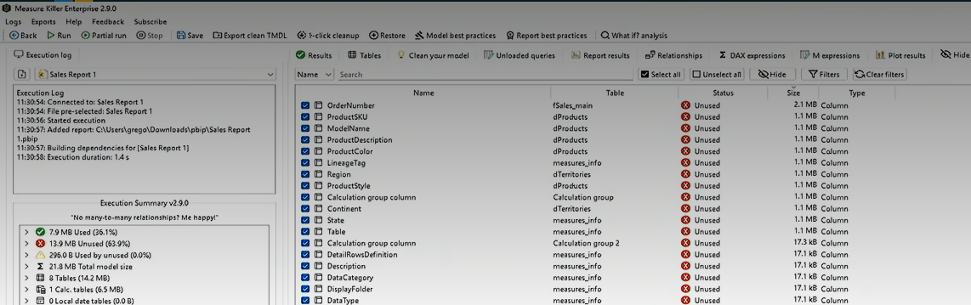
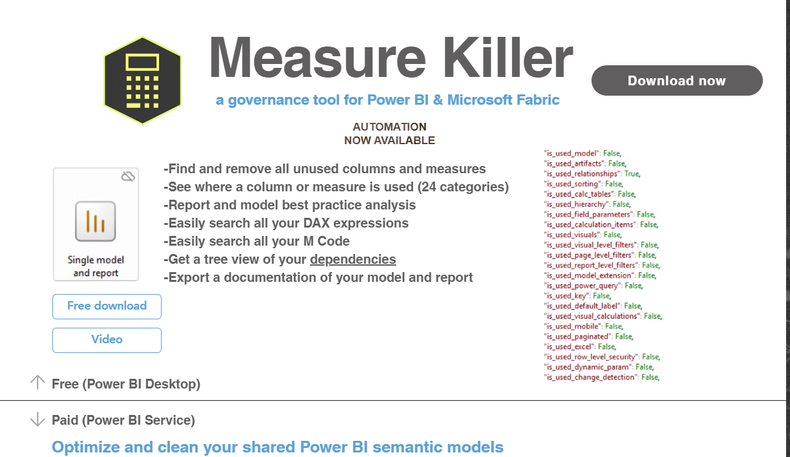
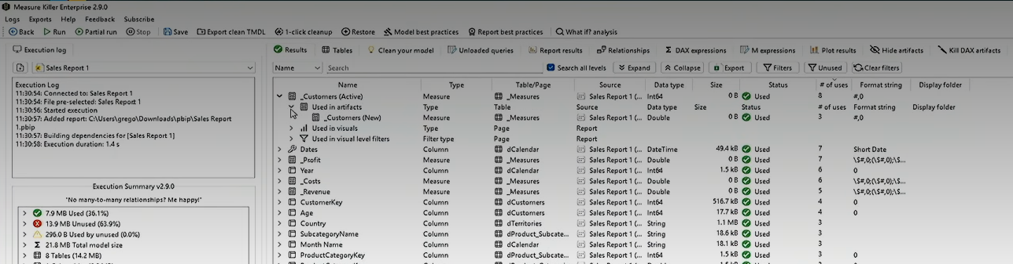
Remove unsed measure and columns using Measure killer
Model optimazation is crucial in power BI datalmodeling. Removing unsed measure and columns will reduce the model size and increase the report speed.
Unused measures an colum ,
Clean up the hole data model (using TMDL views) taking some backup before….
An external tool called measure killer can support doing this.
https://www.udemy.com/course/microsoft-power-bi-masterclass-expand-excellence/learn/lecture/49203701#overview

Slide 6
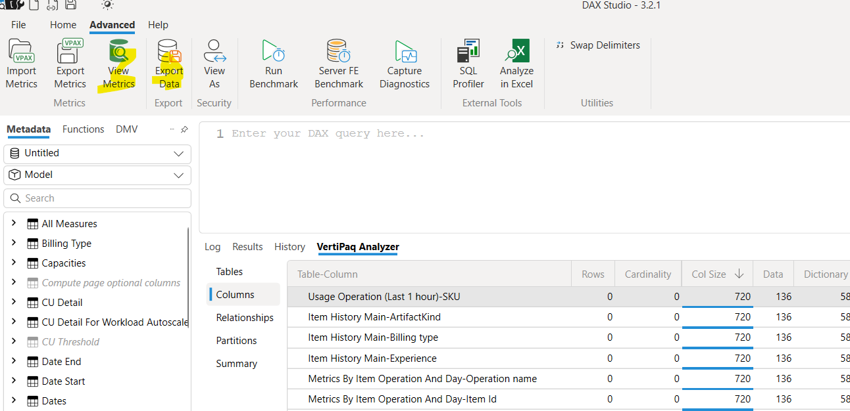
Datamodel optimization using Dax studio-Vertipaq and LLM (chatGpt , Clause…)
When you some issue with you report (error , lows situation…) , you can diagnos the model using Dax Studio and AI pour find the best approach to apply to the model and solve those issues (with an optimized data model ). AI and développer will work togever the find the best ways. The développer will provive the Vertipaq with a good prompt asking some advieses to the AI LLMs.
The Ai output will be anlysed by the développer and validated or not.
Note : the export data will Just contain the meta data.
https://www.udemy.com/course/microsoft-power-bi-masterclass-expand-excellence/learn/lecture/52288257#overview

Slide 7
Count filers visually and dynamically on a current report
In some case you want to know how many filters are applyed to the given measure. There are 2 helfull measure and setting to put in place in order to make this work.
CountFilters =
FORMAT (
IF ( ISFILTERED (Ordertbl[Region]) , 1 )
+ IF ( ISFILTERED (Ordertbl[CustomerCountry]) , 1 )
+ IF ( ISFILTERED (Ordertbl[ShipMode]) , 1 )
‘#’
)
2. CountFilterFormat = IF([CountFilers] = ‘’ , ‘#FFFFFF00’ ,’##0F3D6E’)
The second phase is to use those measures at property side (see vidoe)
https://www.udemy.com/course/microsoft-power-bi-masterclass-expand-excellence/learn/lecture/53728701#overview

